Slide 1
DEPARTMENT OF COMPUTER SCIENCE & ENGINEERING SCHOOL OF COMPUTING
10214CS501
COMMUNITY SERVICE PROJECT WINTER SEMESTER(2025-2026)
REVIEW - II
“SMART IRRIGATION SYSTEM”
SUPERVISED BY
PRESENTED BY
Faculty Name:Dr.palpand.subbaiah Designation: ASSISTANT PROFESSOR
1. Student name : E. PADMAVATHI (VTU30457)(24UECS0556)
2. Student name : M.SAMATHA VAISHNAVI (VTU29022)(24UECS0717
3. Student name : G.VIJAY KUMAR (VTU30133)(24UECS0559)
DEPARTMENT OF COMPUTER SCIENCE & ENGINEERING

Slide 2
Agenda
ABSTRACT OBJECTIVE
INTRODUCTION ABOUT VILLAGE
ACTIVITY LOG SURVEY
SURVEY ANALYSIS WITH REPORT
SOCIETY RELEVANT PROBLEM IDENTIFICATION NOVEL IDEA GENERATION PROTOTYPE/DEVELOPMENT OF NEW SOLUTION GEOTAGGED PHOTOS AND DETAIL&VIDEO LINK AUTHENTICATED SIGNATURES PROOF AND DETAIL PLAGIARISM REPORT
DEPARTMENT OF COMPUTER SCIENCE & ENGINEERING

Slide 3
ABSTRACT
The project recognizes the critical role of irrigation in enhancing crop productivity and sustainability, and it explores various irrigation techniques suited for rural environments.
The project focuses on three primary objectives: assessing the feasibility and efficiency of different irrigation methods, evaluating their impact on water conservation and crop yield, and promoting the adoption of sustainable irrigation practices.
The proposed smart irrigation system integrates various components, including soil moisture sensors, weather data analysis, automation control, and communication technologies.
Soil moisture sensors are deployed in the field to monitor real-time soil moisture levels, providing accurate data on the water requirements of crops or plants.
DEPARTMENT OF COMPUTER SCIENCE & ENGINEERING

Slide 4
OBJECTIVES
Aim of the Project: To address the challenges faced by farmers in rural regions in accessing adequate water resources for agricultural activities.
Scope of the Project:
The project involves designing a smart irrigation system that integrates soil moisture sensors, weather data analysis, automation control, and communication technologies.
The project includes deploying soil moisture sensors in the agricultural or landscaping fields to monitor real-time soil moisture levels. The number and locations of sensors are determined to provide comprehensive coverage for accurate data collection.
The project involves incorporating microcontrollers and actuators to automate the irrigation process.
DEPARTMENT OF COMPUTER SCIENCE & ENGINEERING

Slide 5
INTRODUCTION ABOUT VILLAGE
Welcome to MATOOR, this village is located in the Khammam Distict of Telengana. Matoor is a village renowned for its lifestyle.
The village is blessed with fertile lands and abundant natural resources, providing an ideal setting for agricultural activities. However, like many rural areas, Matoor faces its own set of challenges.
Traditional farming methods, reliant on chemical inputs, have taken a toll on the environment and soil health over the years.
Situated in a region where agriculture region supreme, the village’s livelihood is intricately tied to the cultivation of crops and the bounty of the land. However, despite its rich agricultural heritage, the village faces an array of challenges, primarily concerning irrigation facilities.
Water scarcity during critical farming seasons has slow crop growth and productivity, posing a substantial threat to the economical well-being of its residents.
DEPARTMENT OF COMPUTER SCIENCE & ENGINEERING

Slide 6
ACTIVITY LOG(10 Days mandatory)
Day/Date
24/11/24
14/12/24
19/12/24
22/12/24
31/12/24
Brief Description of the daily activity
Selected the project
survey
Conclusion on survey
Found solution for the problem awareness for farmers about smart
Learning Outcome
Got to know that there is a major problem in fields
problem they are rising in the
Major problems delay of water
^{s}T^{u}o^{p}d^{p}e^{ly}ve^{f}lºo^{r}p^{th}a^{e}d^{f}e^{i}v^{el}i^{d}ce^{s} that helps
^{f}W^{ar}e^{m}h^{e}a^{r}v^{s}e to make some rural camps
DEPARTMENT OF COMPUTER SCIENCE & ENGINEERING

Slide 7
SURVEY-DETAILS
How often do you currently water your crops?
Daily Weekly Bi-weekly Monthly
What method do you use for irrigation? Manual (e.g., using a hose)
Drip irrigation Sprinkler system Other (please specify)
How satisfied are you with your current irrigation method? Very satisfied
Satisfied Unsatisfied Very unsatisfied
DEPARTMENT OF COMPUTER SCIENCE & ENGINEERING

Slide 8
SURVEY-DETAILS
Do you face water shortages during the irrigation season?
Often
Sometimes
Rarely
Never
How do you typically determine when to water your crops?
Fixed schedule
Visual inspection of crops
Weather forecast
Soil moisture sensors
Are you aware of Smart Irrigation Systems?
Yes, very familiar
Yes, somewhat familiar
No, but I've heard about them No, not at all

Slide 9
SURVEY-DETAILS
Would you be interested in adopting a Smart Irrigation System? Definitely
Probably Not sure Probably not
What is your primary concern about adopting a Smart Irrigation System?
Cost Complexity Reliability Maintenance
How important is water conservation to you in farming practices? Very important
Important Neutral
Not important

Slide 10
SURVEY-DETAILS
Do you believe Smart Irrigation Systems can help save water?
Definitely
Probably
Not sure
Probably not
What features would you consider most important in a Smart
Irrigation System?
Remote monitoring and control
Automated watering based on weather/soil data
Water usage tracking
Integration with other smart farming technologies
How much would you be willing to invest in a Smart Irrigation
System?
Less than $500
$500 - $1000
$1000 - $2000
More than $2000

Slide 11
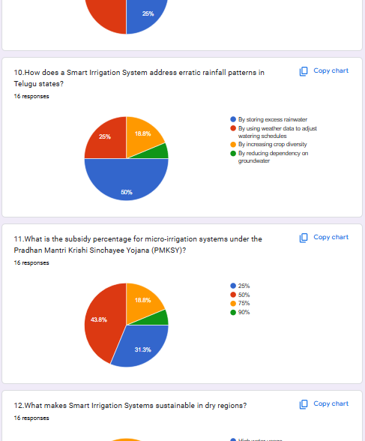
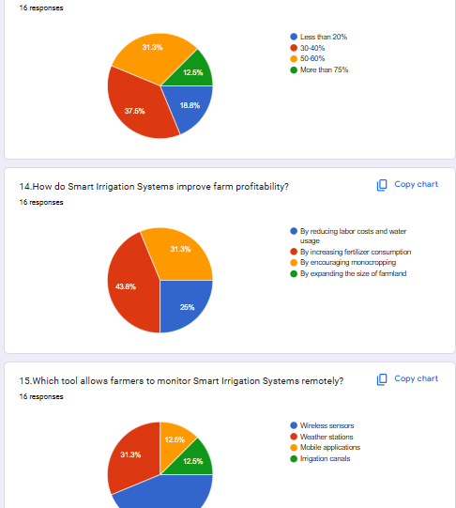
SURVEY ANALYSIS
DEPARTMENT OF COMPUTER SCIENCE & ENGINEERING

Slide 12
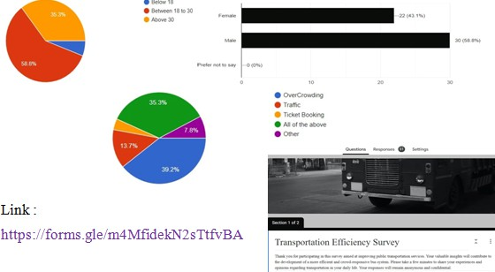
SURVEY ANALYSIS
Sample
DEPARTMENT OF COMPUTER SCIENCE & ENGINEERING

Slide 13
SOCIETY RELEVANT PROBLEM IDENTIFICATION
In many rural areas, water scarcity is a significant problem, leading to insufficient water for irrigation. Some irrigation methods might exacerbate this issue by being water-intensive or insufficient, further straining limited water resources.
Certain irrigation techniques, such as flood irrigation , may lead to excessive water usage, resulting in water wastage and potential environmental impacts like soil erosion and waterlogging.
Traditional irrigation methods can be labor-intensive and costly for farmers. High expenses for irrigation may reduce their profits and overall economic well-being.
Many farmers might not have access to or be aware of modern irrigation technologies, which can limit their ability to adopt more efficient and sustainable methods.
In regions heavily reliant on rain-fed agriculture, unpredictable rainfall patterns due to agricultural productivity and food security.
DEPARTMENT OF COMPUTER SCIENCE & ENGINEERING

Slide 14
PROTOTYPE/DEVELOPMENT OF NEW SOLUTION
Identify and evaluate modern irrigation technologies and systems, such as drip irrigation, sprinkler systems, and rainwater harvesting methods.
Assess the feasibility and cost-effectiveness of adopting these technologies for small-scale and resource-constrained farmers in the community.
Construction of water reservoir in the villages by the government will lead reduce the water scarcity.
Smart irrigation system using the machine learning. We can use the IOT technology to develop this project. The development of a new smart irrigation system for efficient water management in agriculture and landscaping.
This innovative system integrates advanced technologies, including soil moisture sensors, weather data analysis, automation control, and remote access capabilities. Soil moisture sensors are strategically deployed in the fields to continuously monitor real-time moisture levels, providing accurate data on crop water requirements.
DEPARTMENT OF COMPUTER SCIENCE & ENGINEERING

Slide 15
PROTOTYPE/DEVELOPMENT OF NEW SOLUTION
The system leverages weather data to anticipate environmental conditions and adjust irrigation schedules accordingly, ensuring optimal water usage. Automation and microcontrollers enable autonomous irrigation events, minimizing water wastage while maximizing crop health and yield.
Moreover, the user-friendly interface allows farmers to remotely control and monitor the system, empowering them to make real-time adjustments and optimize irrigation practices. This new smart irrigation system offers a sustainable and environmentally conscious approach to water conservation, promoting resource efficiency and productivity in agriculture and landscaping industries.
DEPARTMENT OF COMPUTER SCIENCE & ENGINEERING

Slide 16
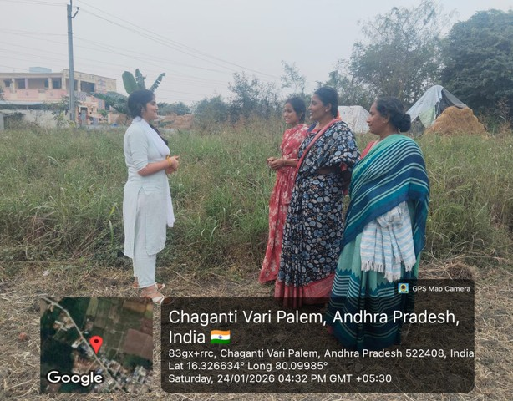
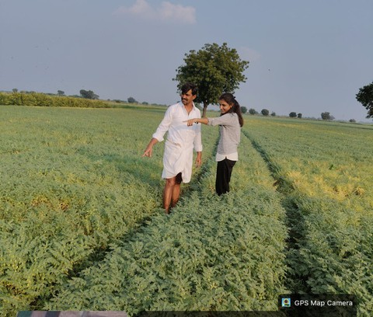
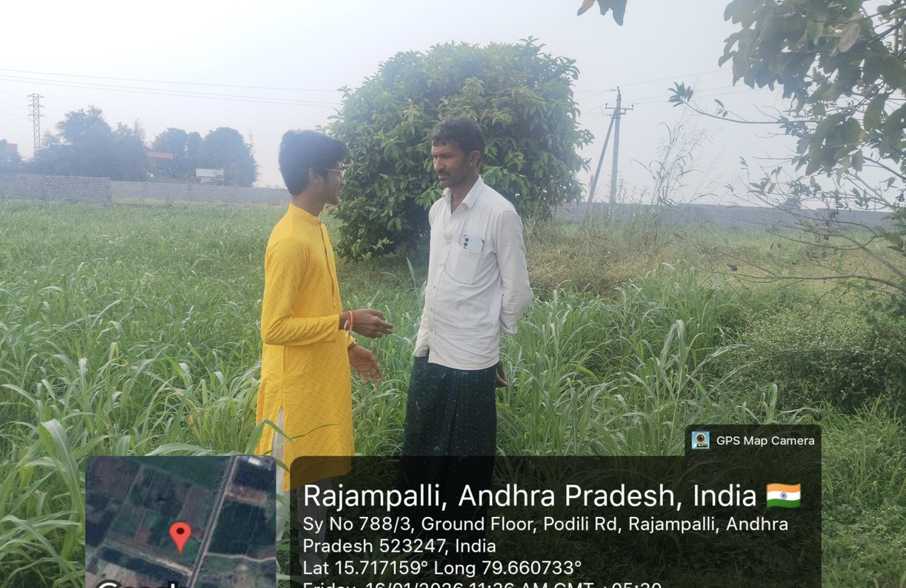
GEO TAGGED PHOTOS ,VIDEO LINK

Slide 17
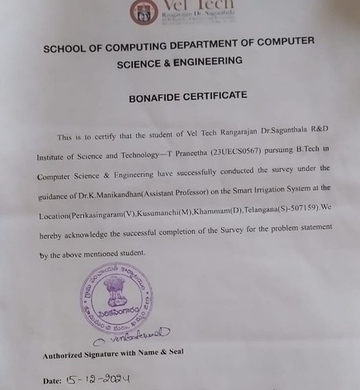
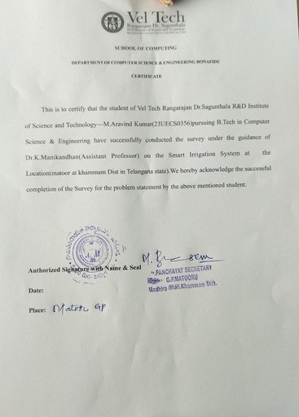
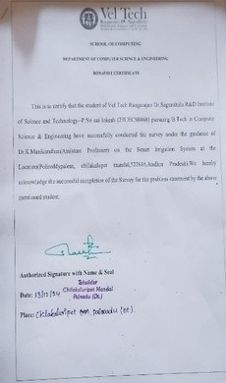
AUTHENTICATED SIGNATURES PROOF AND DETAIL.
Sample.1
DEPARTMENT OF COMPUTER SCIENCE & ENGINEERING

Slide 18
RECOMMENDATIONS AND CONCLUSIONS OF THE SMART IRRIGATION SYSTEM
RECOMMENDATIONS:
Uses of IoT and AI
Weather Integration
Soil Moisture Sensors
Automated Control
Mobile Monitoring
Energy Efficiency
Water Conservation 8.Cost-Benefit Analysis
User Training
Scalability
DEPARTMENT OF COMPUTER SCIENCE & ENGINEERING

Slide 19
RECOMMENDATIONS AND CONCLUSIONS OF THE SMART IRRIGATION SYSTEM
CONCLUSION:
Improved Water Efficiency
Enhanced Crop Yield and Quality
Automation and Labor Reduction
Energy and Cost Savings
Environmental Sustainability
Integration with IoT and AI
Scalability and Adaptability
Climate Resilience
DEPARTMENT OF COMPUTER SCIENCE & ENGINEERING

Slide 20
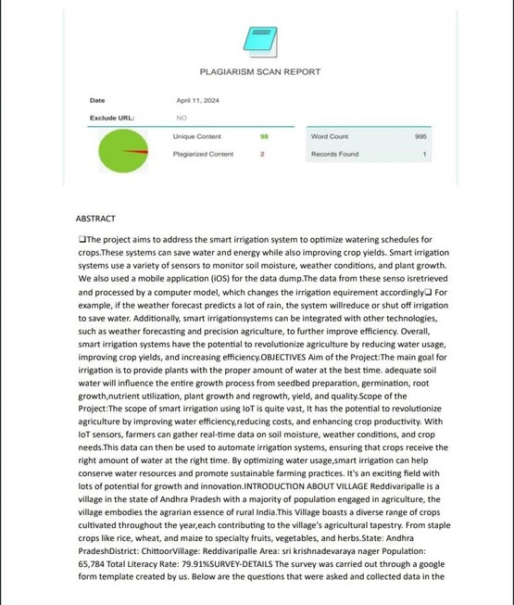
PLAGIARISM REPORT.
BATCH NO:227 DEPARTMENT OF COMPUTER SCIENCE & ENGINEERING

Slide 21
THANK YOU
BATCH NO:227 DEPARTMENT OF COMPUTER SCIENCE & ENGINEERING

